Slide 1
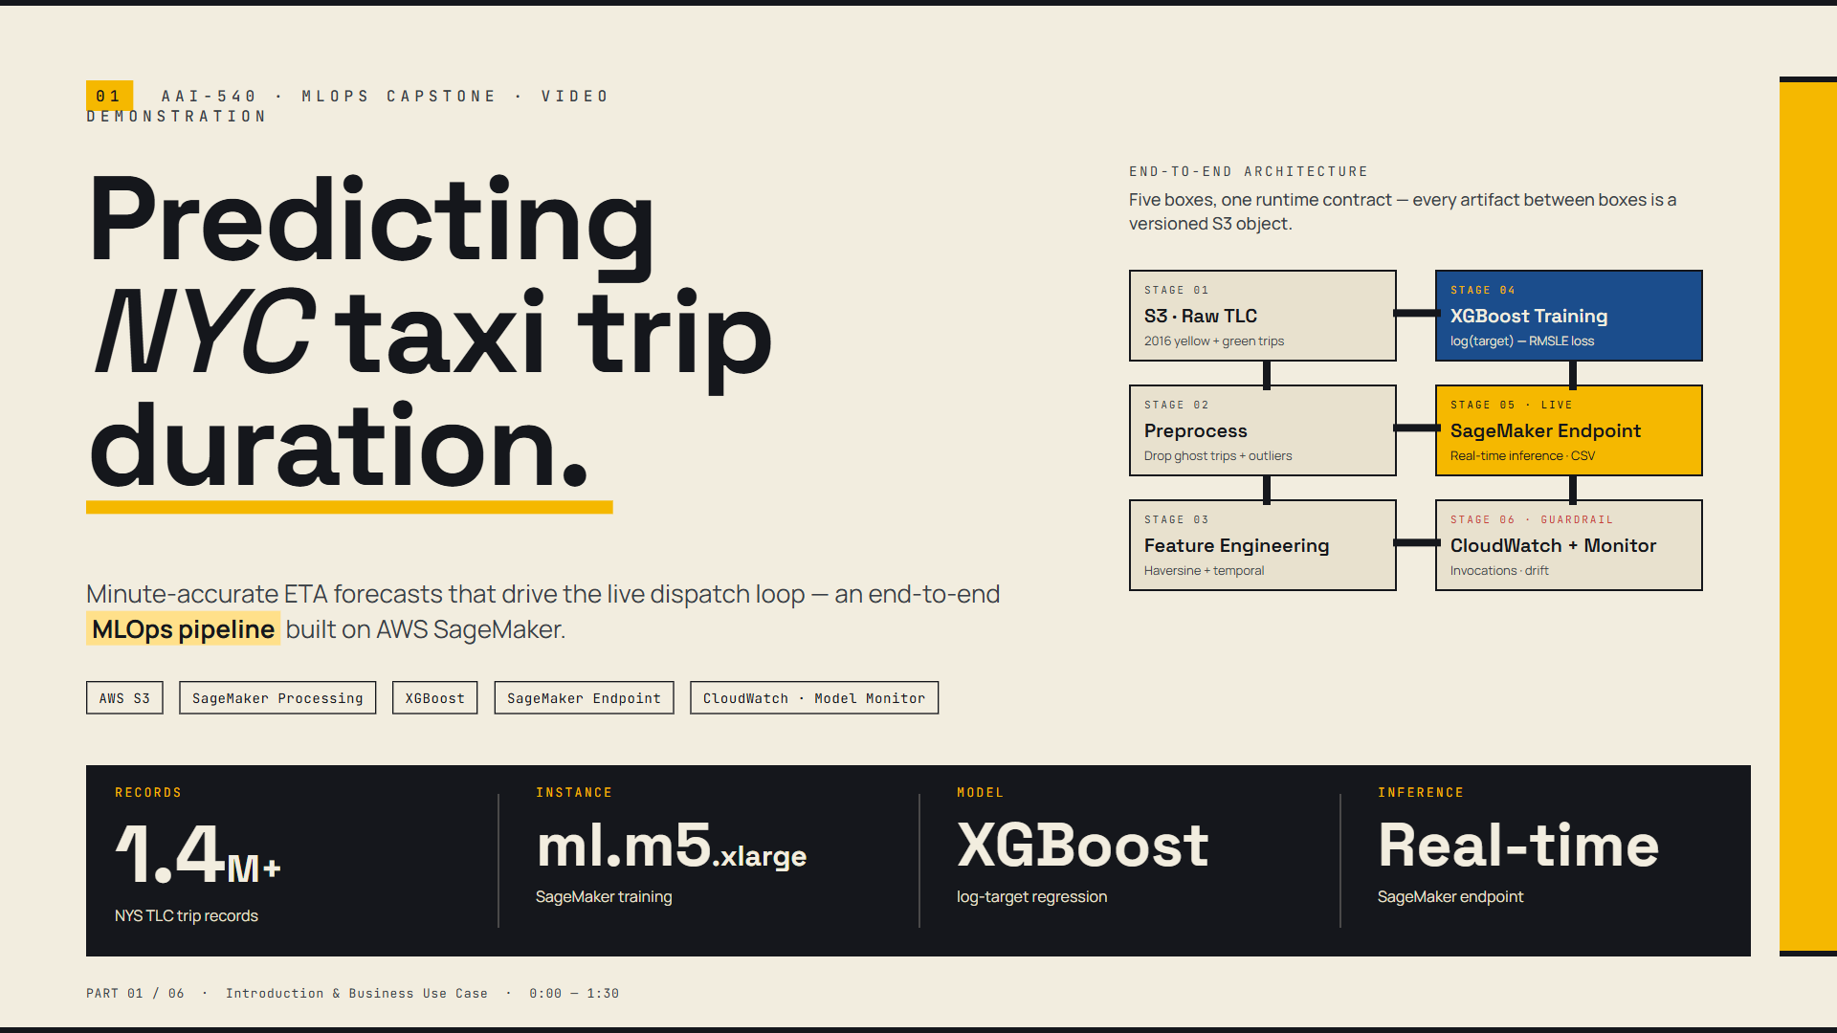

Slide 2
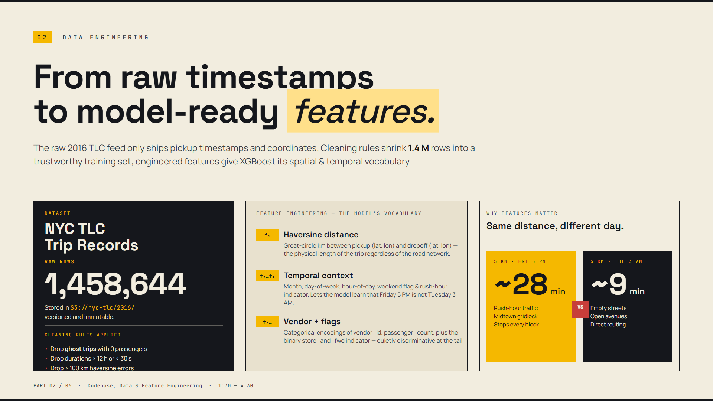

Slide 3
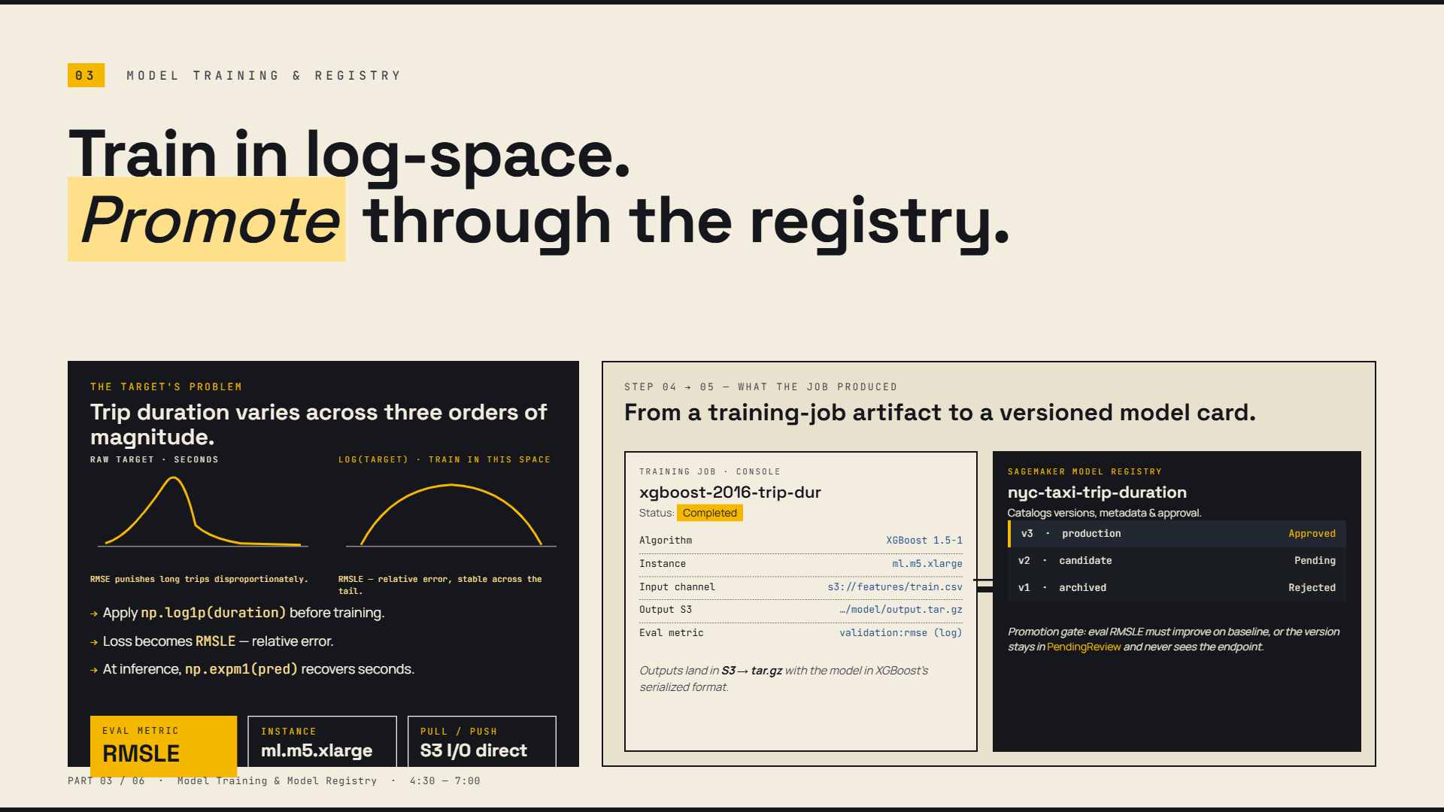

Slide 4
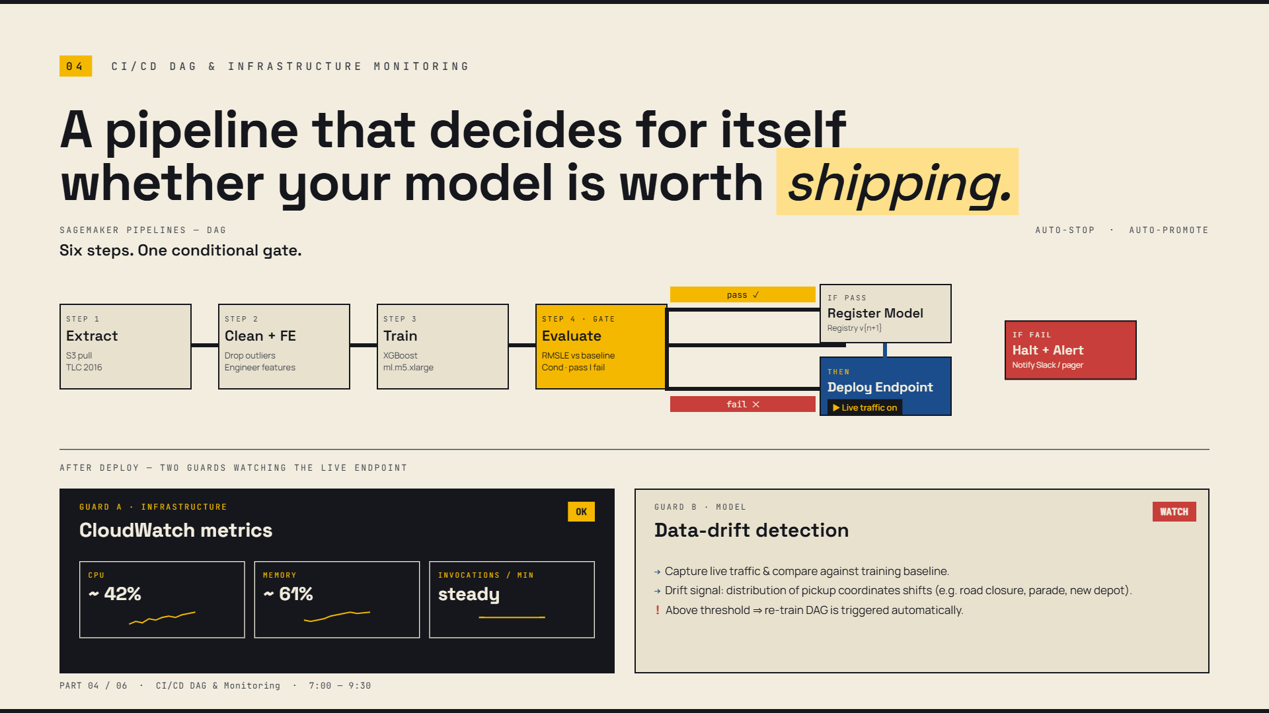

Slide 5
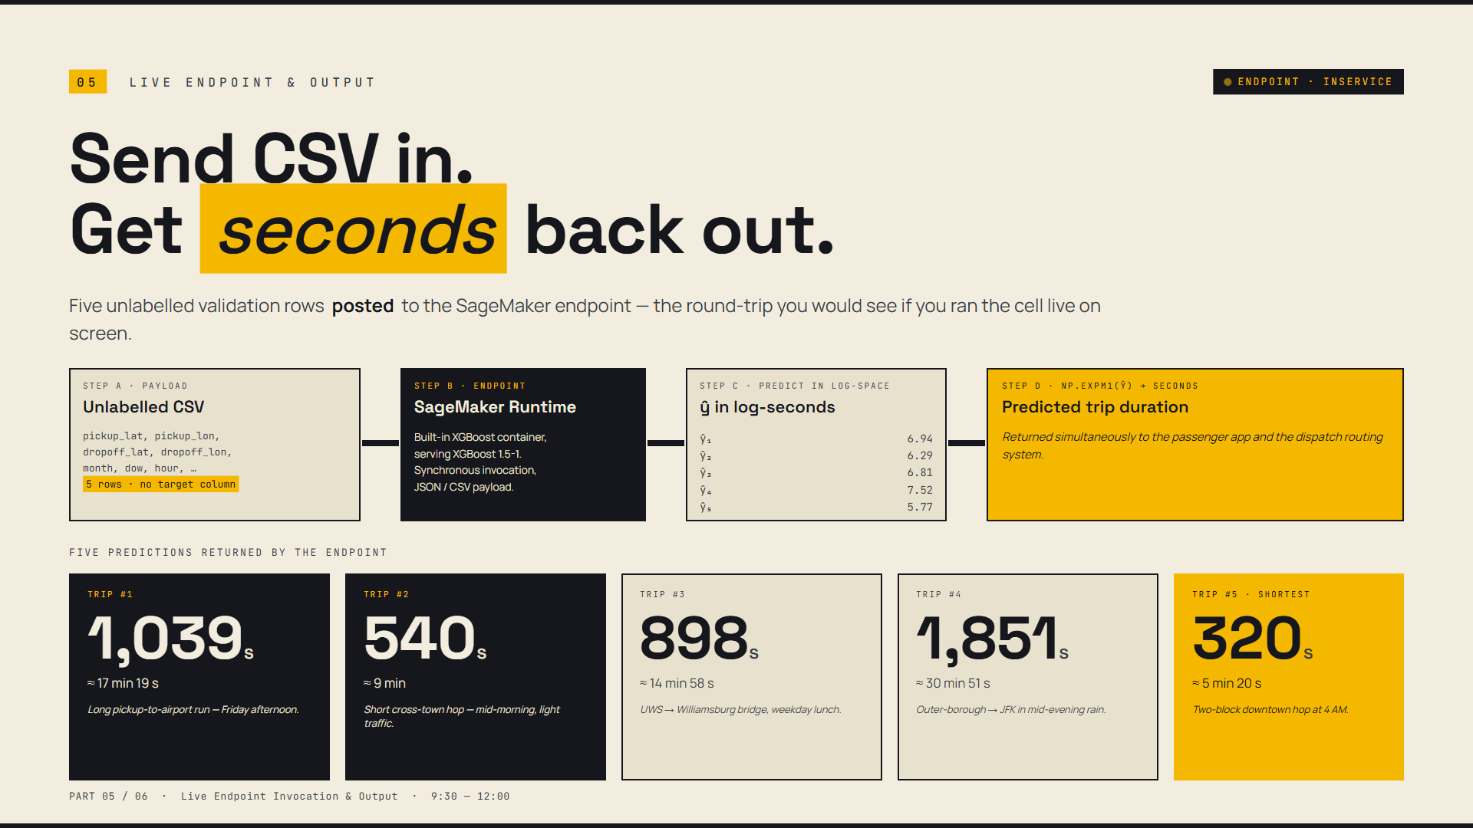

Slide 6
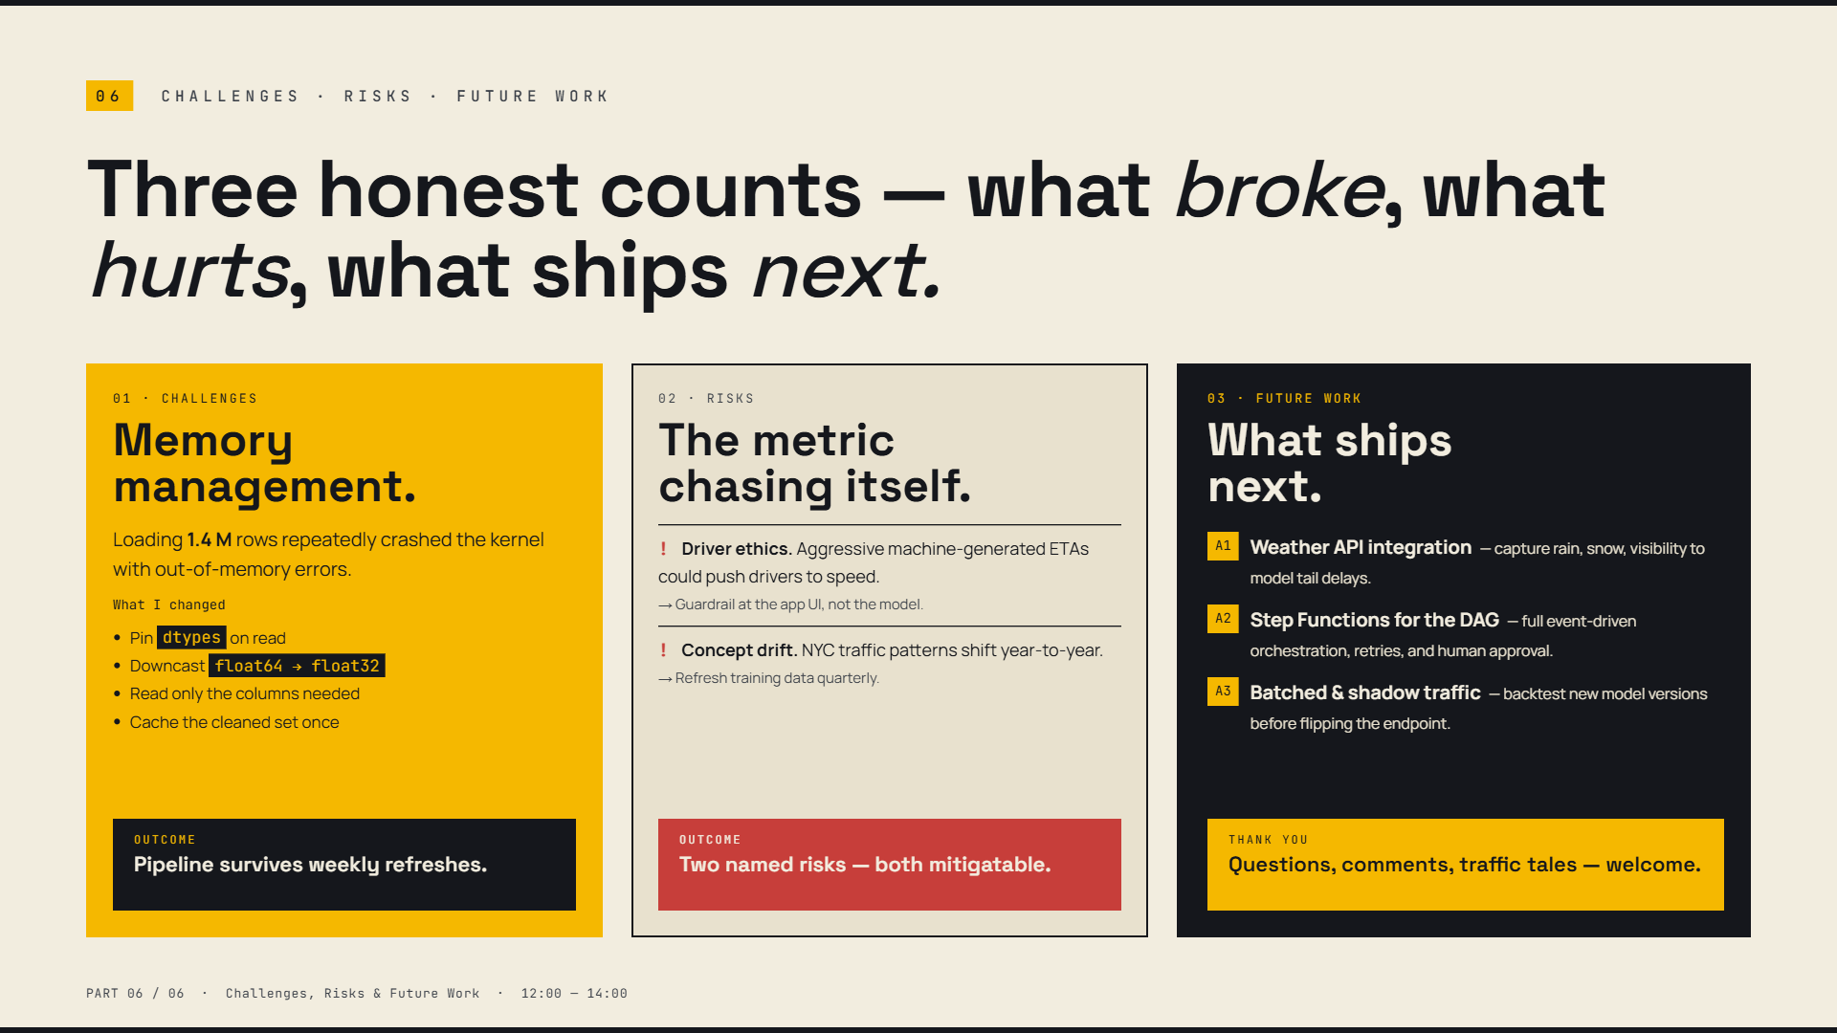

Slide 7
07
WRAP UP · CONTACT · QUESTIONS
Thank you — let's build the future of production ML together.
01 · CONTACT & LINKS
02 · KEY TAKEAWAYS
03 · DISCUSSION
Where to find the work.
What we delivered.
Open floor & Q&A.
GitHub
Docs & Architecture
Email
! Memory Efficiency: Downcasted floats, saved 60% kernel RAM.
! Automated Gates: CI/CD evaluates RMSLE before promotion.
! Drift Guard: Live monitoring catches covariate shifts.
Q1 Traffic Tales: Edge cases in NYC trip duration predictions.
Q2 DAG Scaling: Expanding Step Functions for new feeds.
RESOURCES ONLINE
Repo & notebooks fully public.
SYSTEM STATUS
All pipelines live & healthy.
JOIN THE DISCUSSION
Questions & feedback welcome.

